Slide 1
Block Stacking Robot
Abigail Egya-Mensah, Frank Laubach

Slide 2
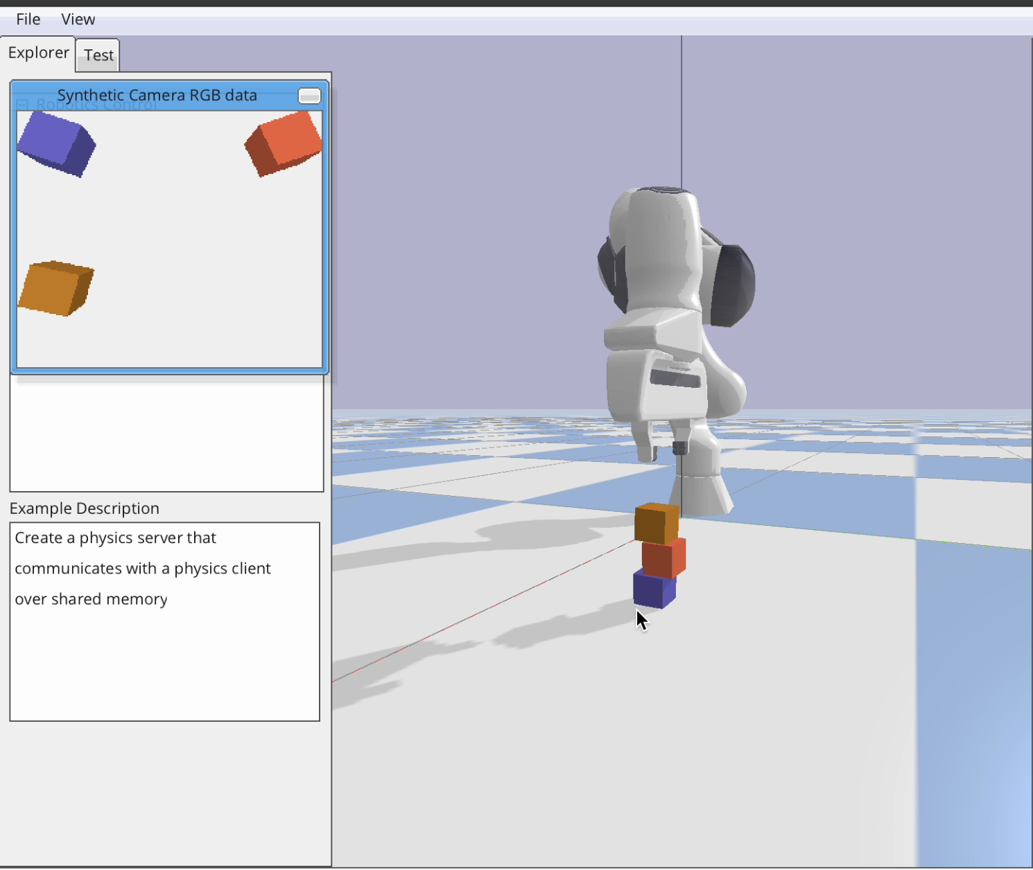
INTRODUCTION
This project’s objective is to enable the robot to accurately perceive block positions and orientations and stack them in the desired configuration.
The program will be tested and evaluated using the Emika Franka arm in the PyBullet simulator, which provides a safe and controlled environment to simulate the robot and the blocks. We implemented the Inverse-kinematics code from HW 6.
The Implemented Methods aside the baseline are
Harris Corner Detection
Haar Cascades

Slide 3
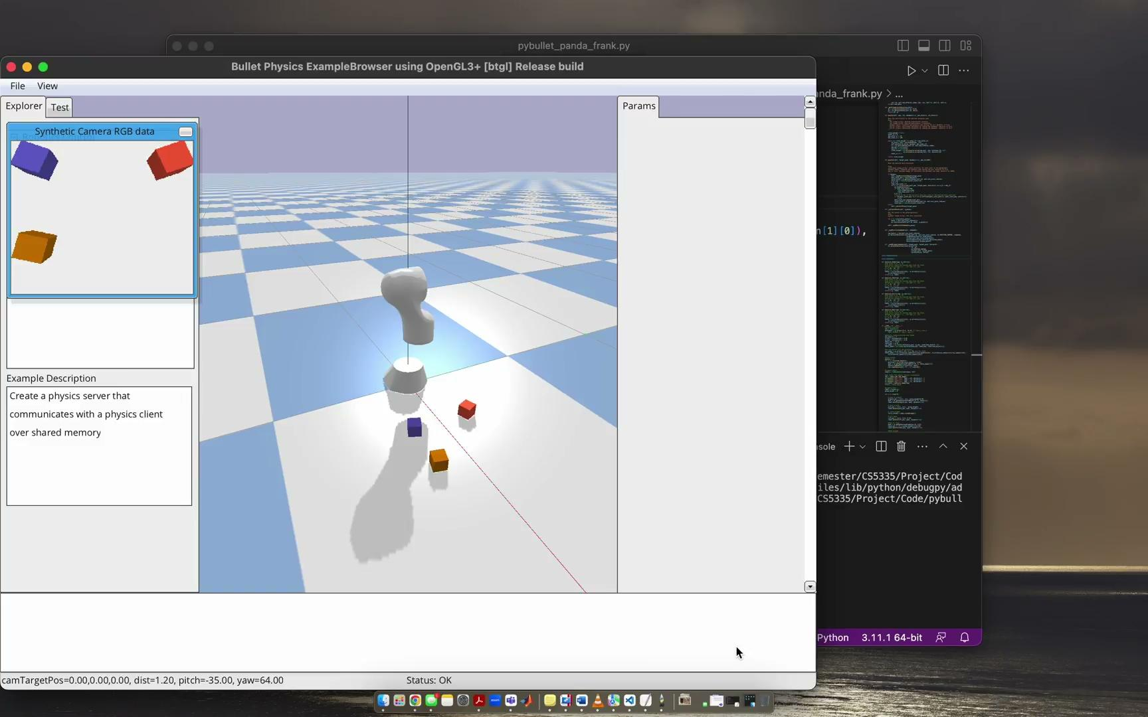
PSEUDOCODE
Prepare simulator
Spawn three (7cm x 7cm) cubes in random locations
Spawn camera and take a picture
Give the image to a method
Method gives coordinates and orientation
Run through the block-stacking loop 3 times

Slide 4
HAAR CASCADE
This function was implemented in Python using the OpenCV library. It works by applying a set of pre-defined Haar features to the image and using them to classify whether a region of the image contains the object of interest or not. It is designed for object detection based on image features, and does not have a built-in capability for detecting the orientation of objects.
A Classifier is need for Haar Cascade Implementation. The following steps were used to generate a classifier:
Generate negative and positive samples
Train classifier using the opencv_traincascade command
Test the trained classifier on a new image using the detectMultiScale method of the CascadeClassifier class from Opencv

Slide 5

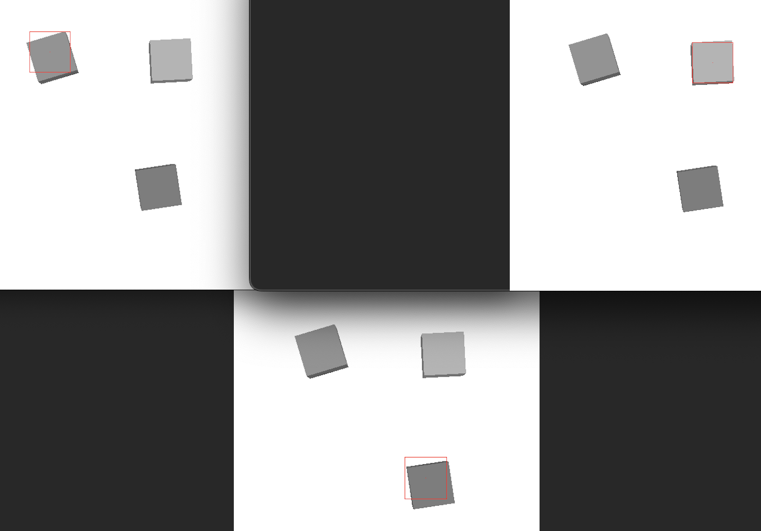
HAAR CASCADE - CONT.
Implement the classifier in the Haar function code. Once the blocks have been detected using the Haar Cascade classifier, the code calculates the x and y position of the center of each block and converts it to meters based on the provided workspace. The calculated x and y positions are stored in the x_meters and y_meters lists, respectively.

Slide 6
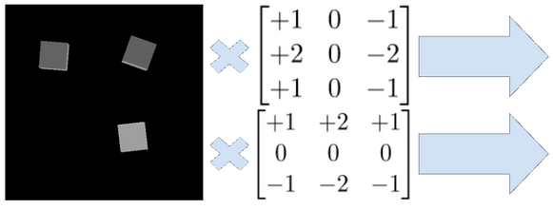
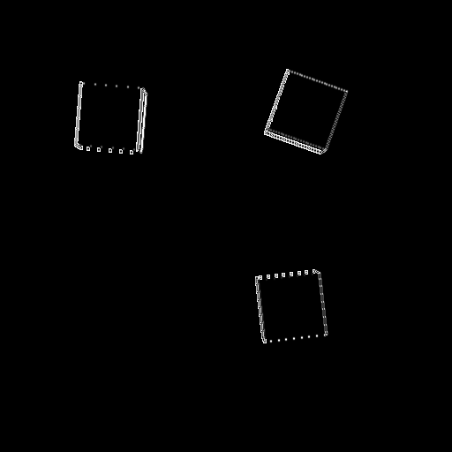
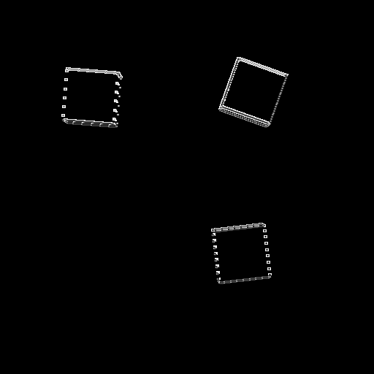


HARRIS POINTS
The method convolves the image using directional weights to get Ix and Iy
Ix and Iy → IxIx, IyIy, and Ixy
→ structure tensor M, Harris values R
Harris values are filtered to give Harris points

Slide 7
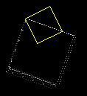
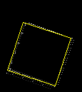
HARRIS POINTS - CONT.
Squares are fit to the Harris points
‘Scores’ are calculated based on nearby points
The highest scoring square is found
neighboring test squares eliminated
Repeat 3x for 3 locations
Scores Low
Scores High

Slide 8
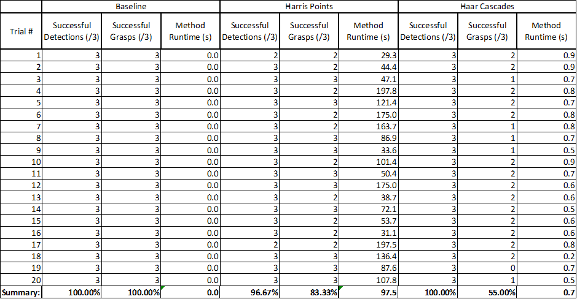
EXPERIMENTS
20 trials were run for each method
3 random blocks
Each method scored on detection, grasp success, and time

Slide 9
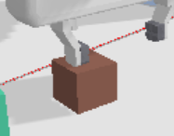
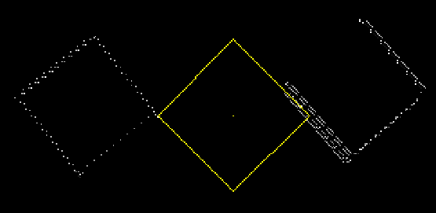
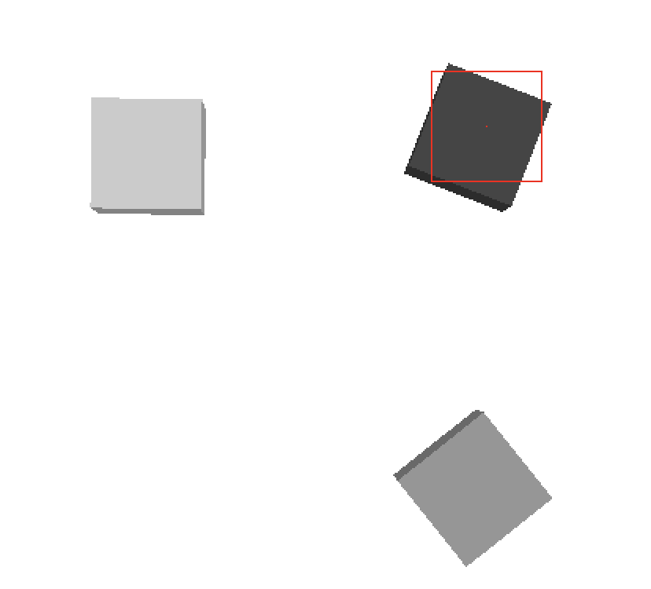
ANALYSIS
Baseline method (giving the robot arm the location) was perfect
Harris method
97% detection
83% grasp
Due to inverse-kinematics issue
98 second execution time
Haar method
100% detection
55% grasp
Cannot detect orientation
1 second execution time

Slide 10
CONCLUSION
Haar Method
Perfect detection
Low execution time
Bad at grasps
Harris Method
Very good detection
High execution time
Good at grasps
Harris is the preferred method
Future: Optimize (reduce points being tested)
Reduce execution time
Perfect detection
Alternative:
Feed Haar position into Harris
Localize square in that location, return orientation
Combine best aspects of both methods

